Slide 1



Multi-class classification of tomato plant leaf diseases using CNN.

Slide 2




Chankit Choudhary
our team
Ayush Sankhyan

Slide 3


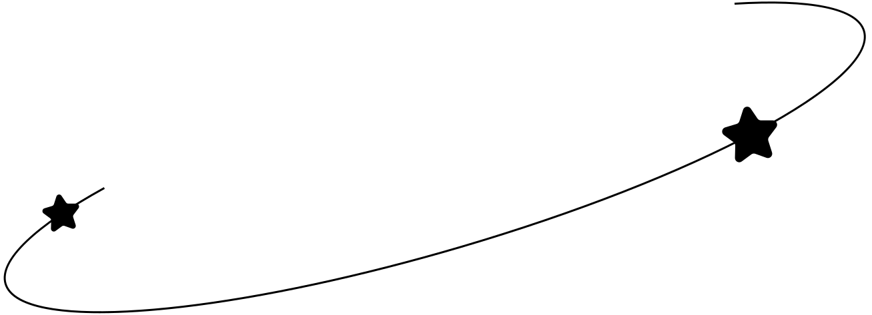
project preview
Multi-class Classification of Tomato Plant Leaf Diseases Using CNN, aims to develop an AI-driven solution for accurately identifying 10 different tomato plant leaf diseases using CNN. Leveraging a Kaggle dataset containing labeled images, we preprocess the data using image augmentation and train a deep learning model with TensorFlow and Keras. The model is evaluated using key performance metrics like accuracy, precision, and recall, ensuring reliable disease detection.

Slide 4

background
Tomato plants are one of the most widely cultivated crops globally, but they are highly vulnerable to various fungal, bacterial, and viral diseases. These diseases can significantly reduce crop yield and quality, leading to economic losses for farmers. Traditionally, disease identification relies on manual inspection by experts, which is time-consuming, subjective, and often inaccessible to small-scale farmers. With advancements in computer vision and deep learning, automated plant disease detection has emerged as a promising solution.

Slide 5
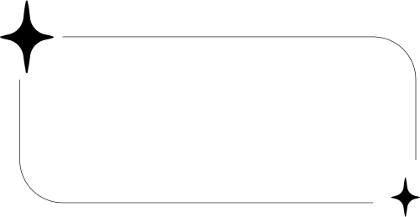
objectives
Develop a CNN-based model to accurately classify 11 different tomato plant leaf diseases using image data.
Deploy the trained model as a mobile-friendly application using Google Cloud Functions, enabling real-time disease detection for farmers and agricultural professionals.

Slide 6
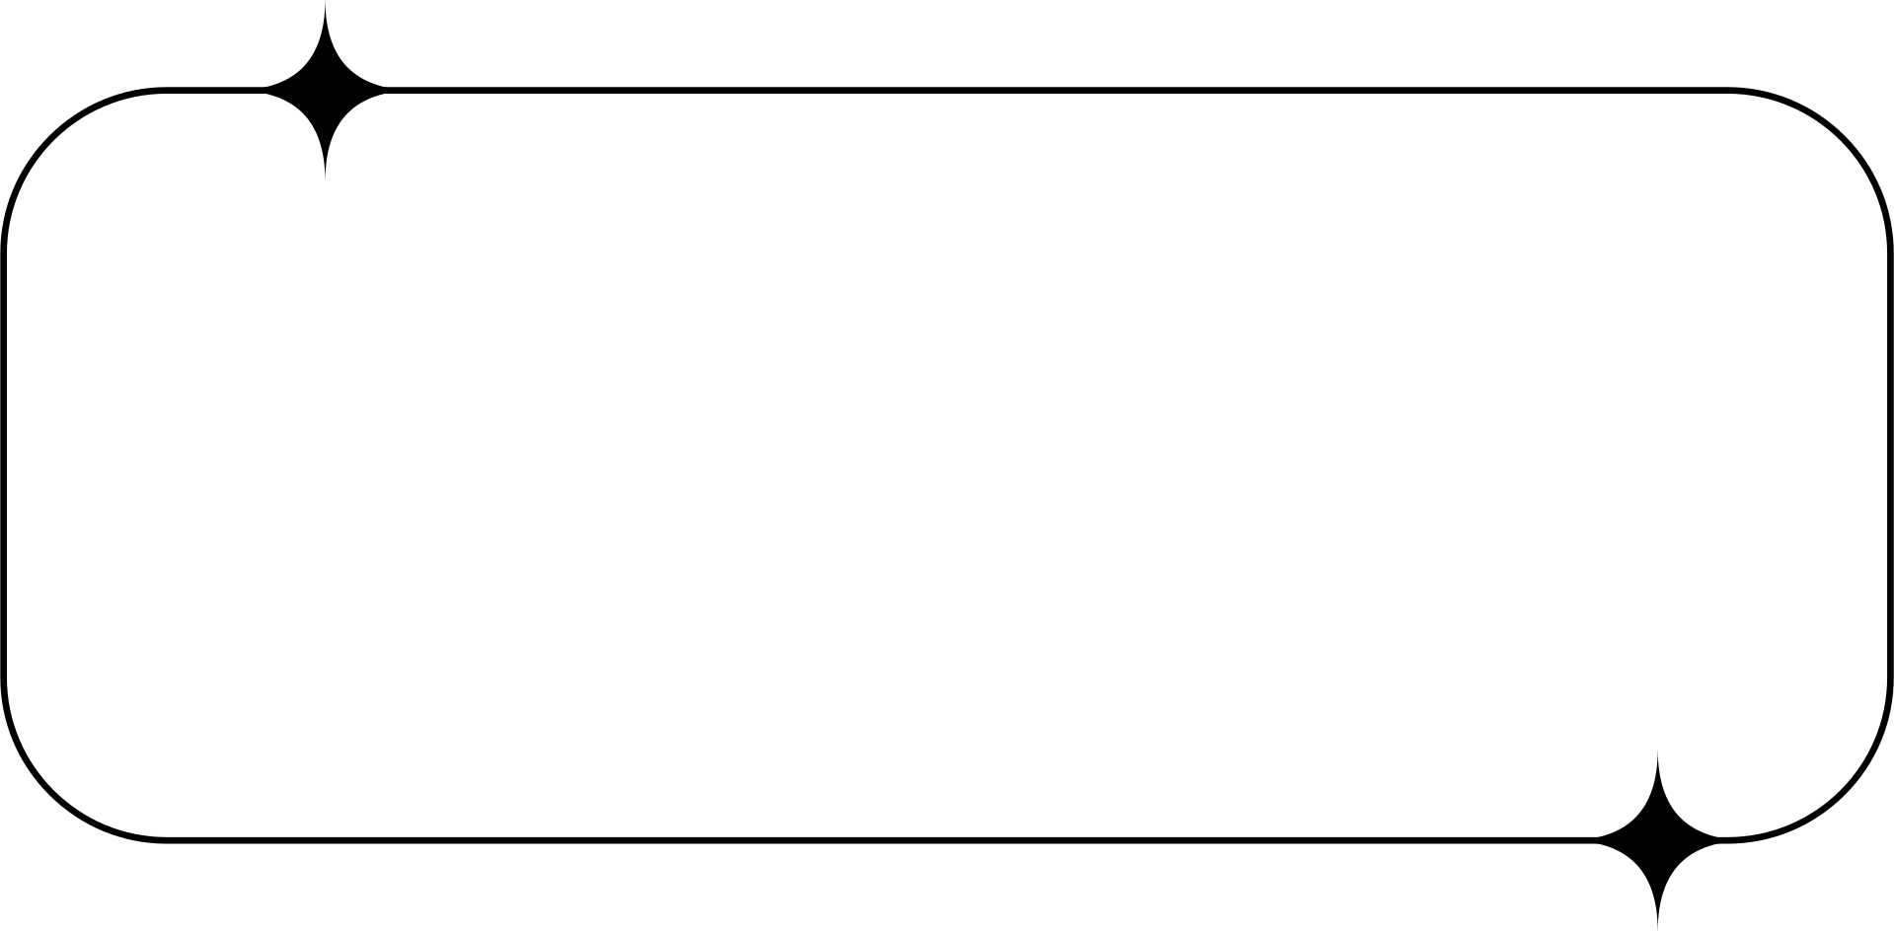
methodology
Data Preprocessing & Augmentation – Collect and preprocess images from the Kaggle dataset by resizing, normalizing, and applying augmentation techniques to improve model generalization.
Model Development & Deployment – Train a CNN model using TensorFlow & Keras, evaluate its performance with key metrics, and deploy it using Google Cloud Functions, integrating it into a React Native mobile app .

Slide 7
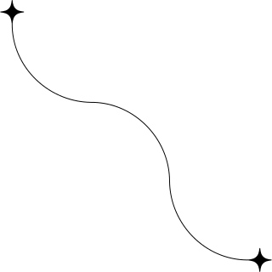

ARCHITECTURE
Key Components:
Data Input: Kaggle image dataset (10 labeled disease classes)
Preprocessing: Image resizing, normalization, augmentation (rotation, zoom, shift)
Model Training: CNN built with TensorFlow and Keras
Model Evaluation: Accuracy, Precision, Recall metrics
Deployment: Model served via Google Cloud Functions
User Interface: Mobile application built using React Native for real-time predictions

Slide 8
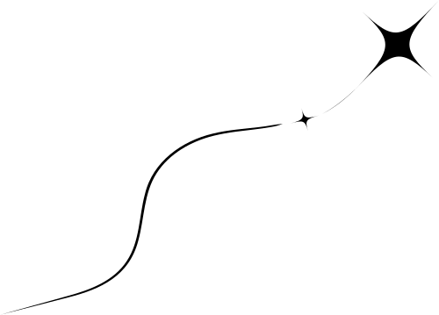
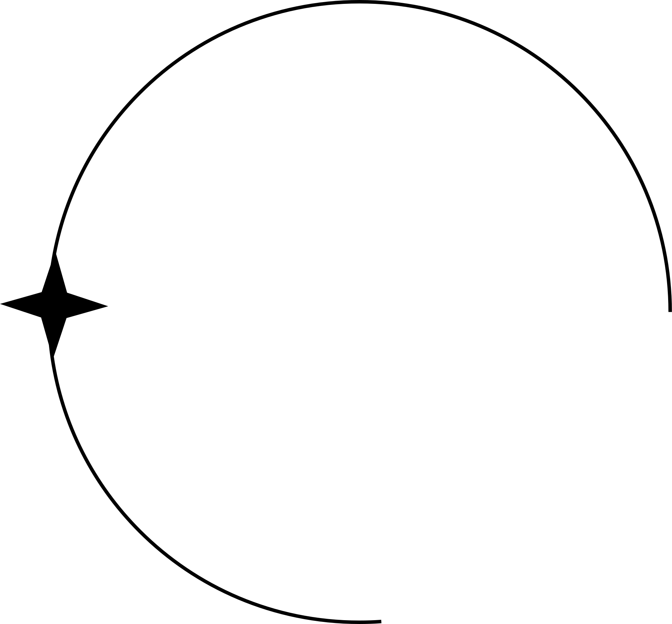
The Challenge
01
02
03
Tomato diseases cost global agriculture over $5 billion annually, according to FAO estimates.
Traditional methods are time-consuming, costly, and subjective.
Automated, rapid, and accurate classification improves crop management

Slide 9

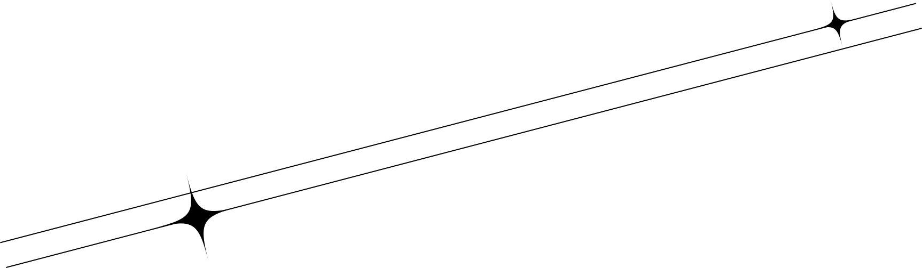
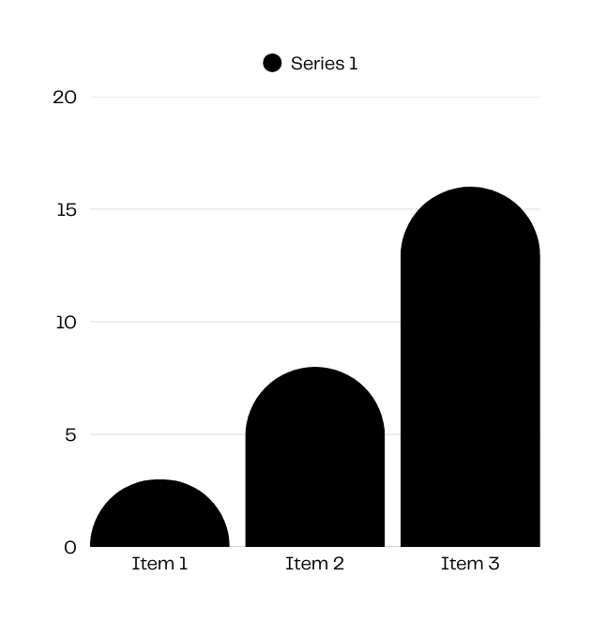
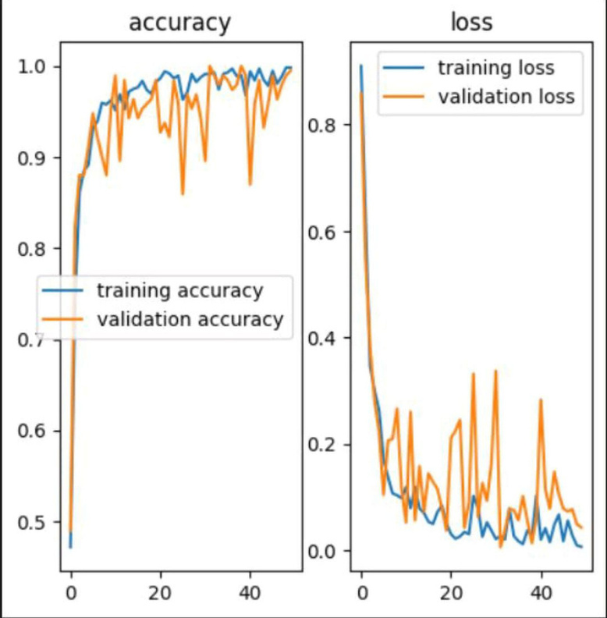


result
The training process of the CNN model for multi-class classification of tomato plant leaf diseases is evaluated using accuracy and loss metrics. The results are visualized in the graphs, which depict training and validation accuracy (left) and training and validation loss (right) over multiple epochs.

Slide 10
APPLICATION
Agricultural Benefits:
Enables early and accurate detection of tomato leaf diseases
Reduces dependency on agricultural experts and manual inspections
Minimizes crop losses and improves yield quality
Wider Applications:
Scalable to other crops and plant diseases using similar architectures.
Can integrate with farm management systems or IoT sensors
Potential to support agricultural policy decisions with data-driven insights

Slide 11
Future WORK
Future improvements for the Multi-Class Classification of Tomato Plant Leaf Diseases Using CNN include enhancing model generalization by expanding the dataset with diverse images and integrating transfer learning techniques.
To reduce overfitting and improve stability, advanced regularization techniques such as L1/L2 weight decay and adaptive learning rate strategies can be implemented.

Slide 12
conclusion
The Multi-Class Classification of Tomato Plant Leaf Diseases Using CNN project successfully demonstrates the potential of deep learning in agricultural disease detection. By utilizing a Convolutional Neural Network (CNN), the model effectively classifies 11 different tomato plant diseases with high accuracy. The results indicate that the model has learned well, achieving strong training and validation accuracy, though minor fluctuations in validation loss suggest scope for further optimization.

Slide 13
thank you

